Slide 1

UTAH STATE UNIVERSITY
AGGIE BAJA
CONTROLS
Preliminary Design Review
Notes:
Ben

Slide 2
Project team
Notes:
Ben

Slide 3
Project purpose
01
Improve the driver controls that have historically received attention late in the vehicle build.
02
Deliver usable, serviceable controls that fit the cockpit and withstand off-road use.
03
Complete installation by the end of March so April remains available for integrated testing.
04
Support the Baja team’s top-10 competition objective through reliable controls.
Notes:
Ben

Slide 4
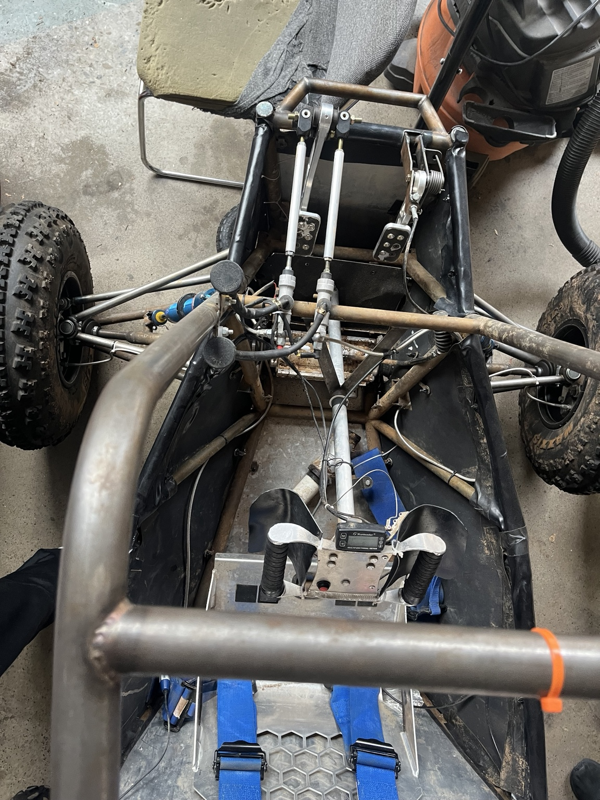
Existing cockpit and customer concerns
Controls compete for space with the steering shaft.
Mud buildup can make steering harder and affect driver control.
Radio and battery retention need a defined mounting approach.
Existing USU vehicle, user-provided photograph
Notes:
Jacob

Slide 5
Safety and functional requirements
Requirement | Threshold | Target
Brake pedal structural load | ≥ 2,000 N | ≥ 2,500 N*
Independent hydraulic circuits | At least 2 | 2
Primary brake coverage | All 4 wheels | All 4 wheels
Throttle travel | Full opening | Full opening
Throttle on release | Return to idle | Return to idle
Egress from either side | ≤ 5 s | ≤ 4 s

Slide 6
Steering and 4WD performance requirements
Metric | Threshold* | Target*
Rotational free play before rack motion | ≤ 5° | ≤ 2°
4WD operating force | ≤ 75 N | ≤ 40 N
4WD engagement time | ≤ 5 s | ≤ 2 s
Repeated engagement success | ≥ 95% | 100%
Notes:
Jacob

Slide 7
Communications and project requirements
Metric | Threshold* | Target*
Two-way radio range | ≥ 250 m | ≥ 500 m
Radio static retention | ≥ 100 N | ≥ 200 N
Battery static retention | ≥ 100 N | ≥ 200 N
Defined vibration test | 0 detachments | 0 detachments
Restrained control reach | All designated drivers | All designated drivers
Installation readiness | March 31, 2027 | March 15, 2027
Notes:
Jacob

Slide 8
Recommended design
Notes:
Ben

Slide 9
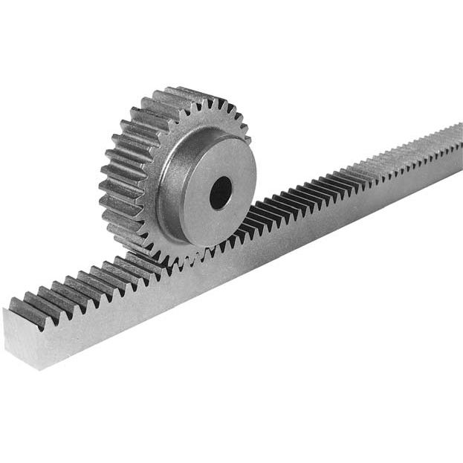
Steering concepts: straight-tooth rack
A spur pinion rotates against a rack with straight teeth.
Rack translation moves the tie rods through the suspension interface.
The shaft and housing support gear loads and maintain tooth alignment.
Adjustment controls operating clearance between the teeth.
Notes:
Jacob

Slide 10
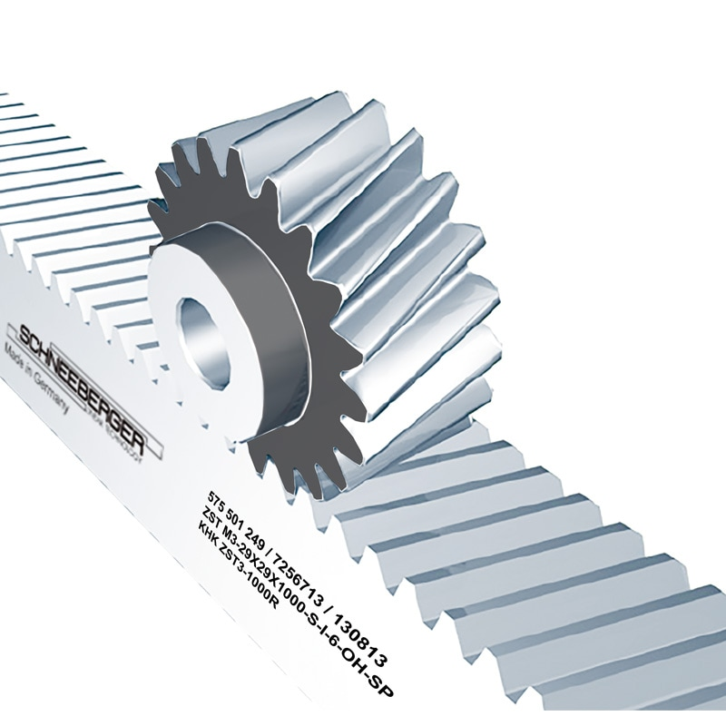
Steering concept: helical rack
A helical pinion meshes with a matching angled-tooth rack.
Rotation produces rack translation through progressive tooth engagement.
The bearing arrangement reacts radial loads and axial thrust.
The housing maintains alignment as steering load changes direction.
Notes:
Jacob

Slide 11
Steering decision matrix
Criterion | Weight | Spur | Helical
Reliability and durability | 35% | 3 | 3
Ease of operation | 20% | 3 | 3
Vehicle integration | 15% | 4 | 2
Ease of fabrication | 20% | 4 | 2
Total cost | 10% | 3 | 3
Weighted score | 100% | 3.35 | 2.65
Notes:
Jacob

Slide 12
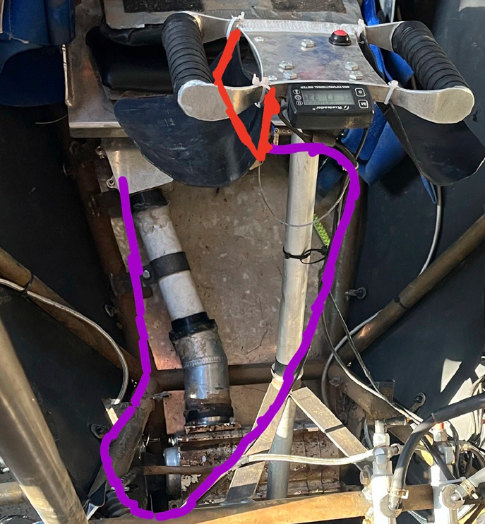
4WD concept: grip-mounted lever
The driver squeezes a paddle beside the yoke hand grip.
A pivot pulls a cable connected to the 4WD clutch.
RED: 4WD paddle / lever
PURPLE: proposed cable route
Notes:
Jacob

Slide 13
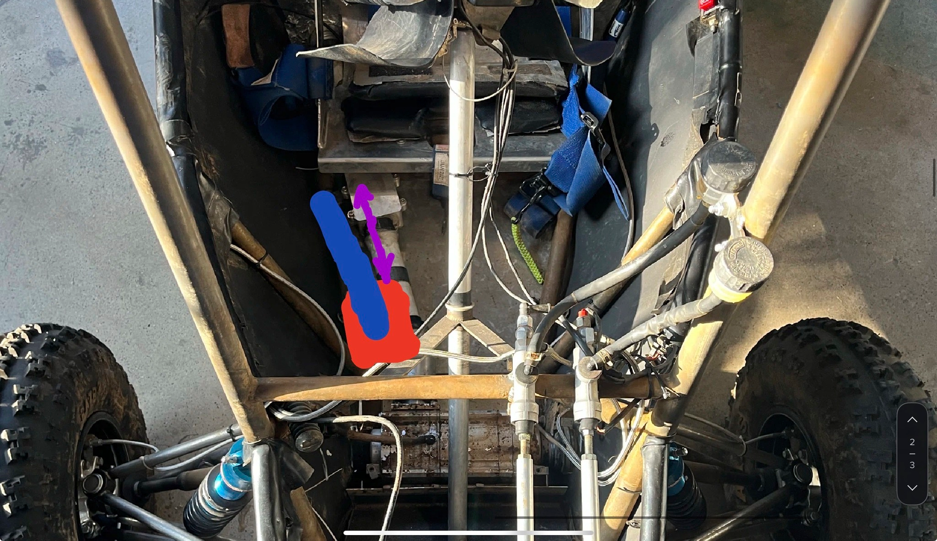
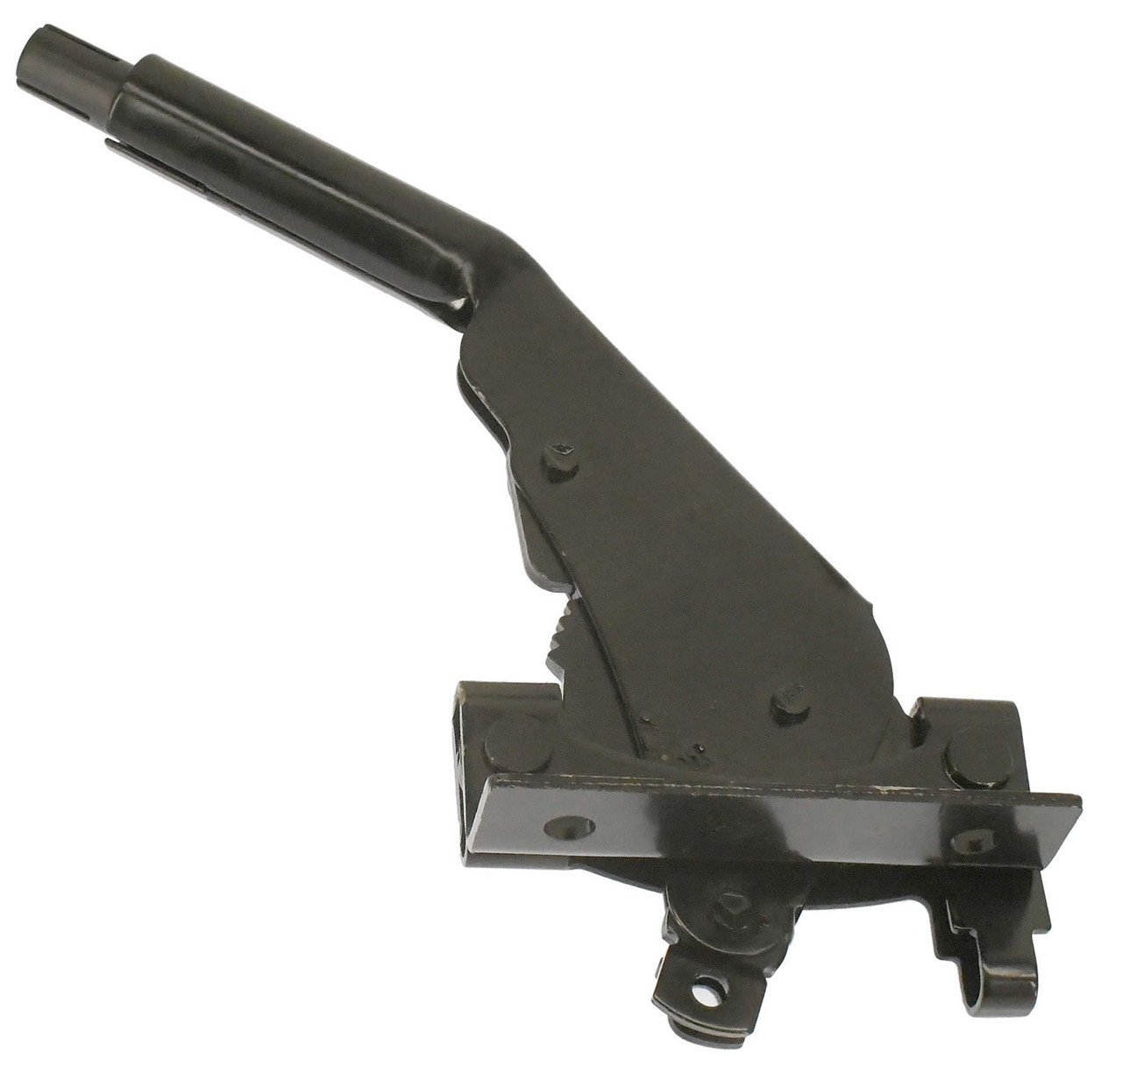
4WD concept: rigid side lever
A lever sits beside the driver’s right thigh on a supported pivot.
A rigid rod and adjustable joints transmit lever movement to the selector.
The driver releases retention and returns the lever to disengage.
BLUE: hand lever
RED: floor mounting bracket
PURPLE: linkage travel
Lever reference
Notes:
Jacob

Slide 14
4WD decision matrix
Criterion | Weight | Handle | Floor mount
Reliability and durability | 35% | 3 | 3
Ease of operation | 20% | 5 | 3
Vehicle integration | 15% | 3 | 2
Ease of fabrication | 20% | 3 | 4
Total cost | 10% | 3 | 3
Weighted score / 5 | 100% | 3.4 | 3.05
Notes:
Jacob

Slide 15
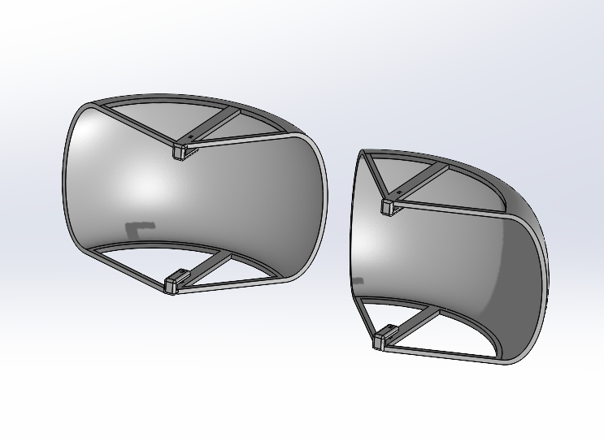
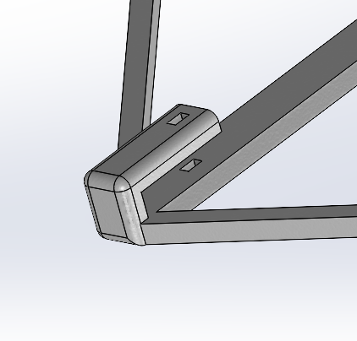
Hand-guard concept
A fitted printed guard surrounds the existing hand-grip area.
The guard aims to reduce mud reaching the driver’s grip.
Its geometry follows the wheel and preserves hand access.
Notes:
Jacob

Slide 16
Four communications architectures
Concept | Driver-to-pit path | Main integration question
MURS kit | Helmet audio and PTT through two radios | Antenna placement and audio compatibility
FRS kit | Helmet audio and PTT through two radios | Fixed antenna location and actual coverage
Cardo mesh | Helmet unit to crew unit / relays | Coverage, charging and relay dependence
Dedicated race kit | Matched radio, audio and harness package | Frequency authorization and total cost
Notes:
Alex

Slide 17
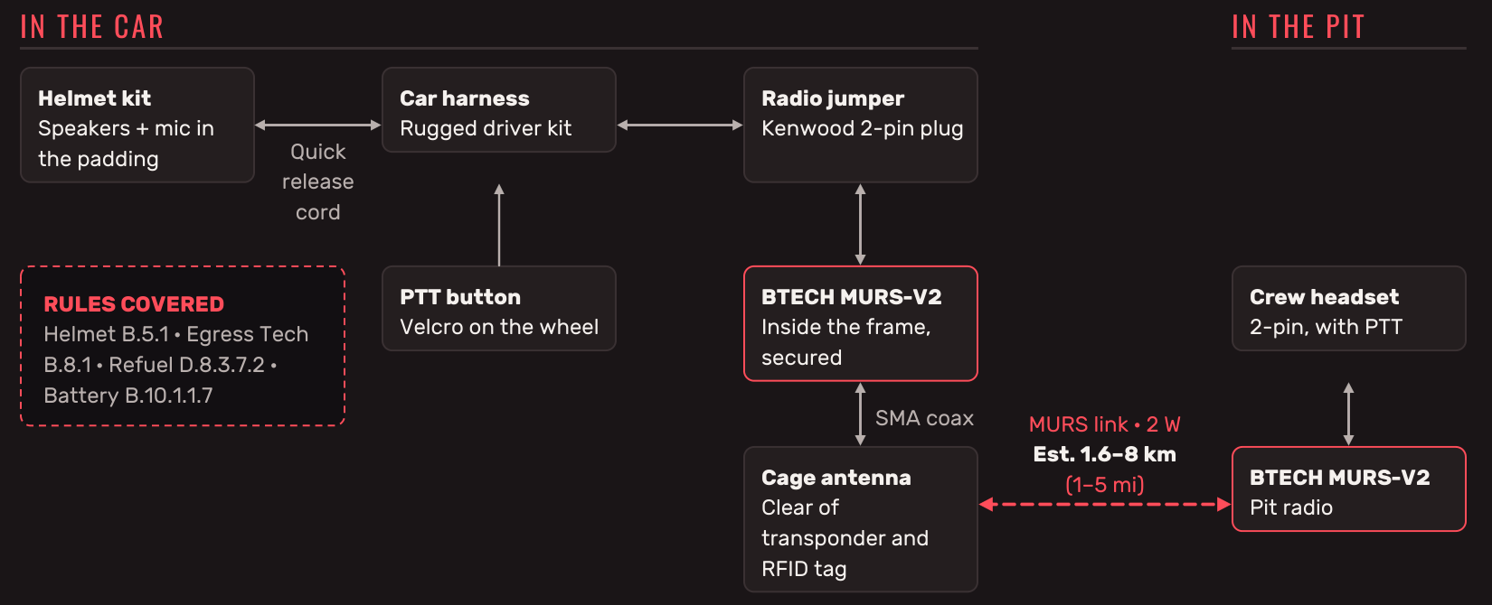
MURS radio concept
Notes:
Alex

Slide 18
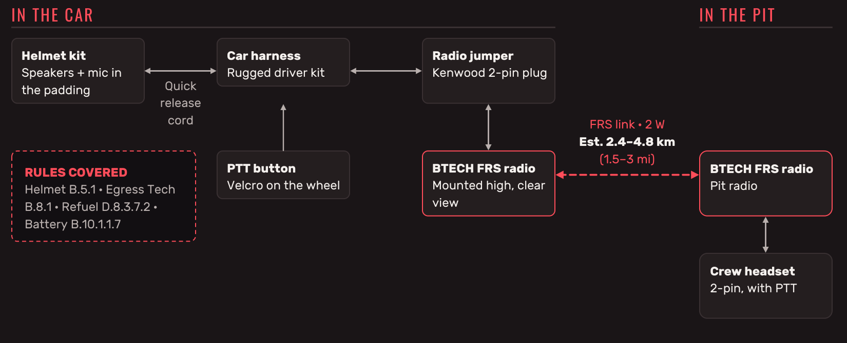
FRS radio concept
Notes:
Alex

Slide 19
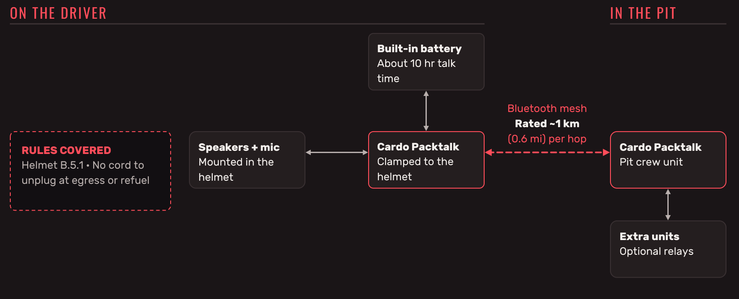
Bluetooth mesh concept
Notes:
Alex

Slide 20
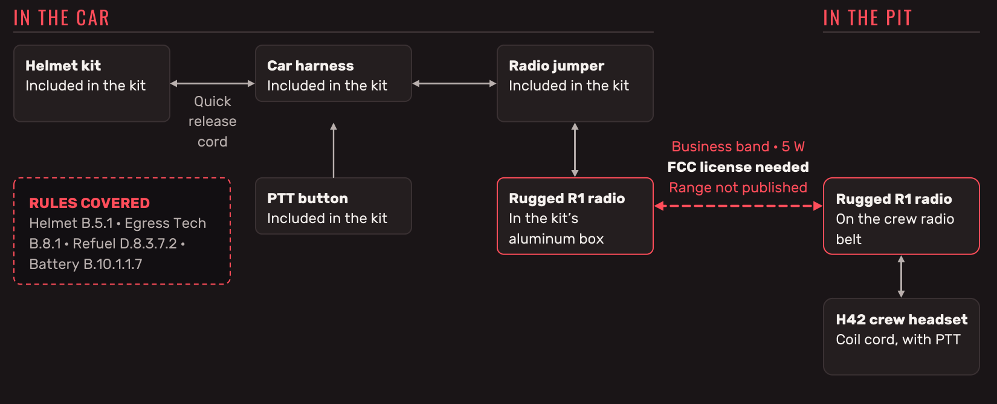
Dedicated race-radio concept
Notes:
Alex

Slide 21
Communications comparison matrix
Criterion | Priority* | MURS (selected) | FRS | Mesh | Race kit
Measured course coverage | High | 4 | 3 | 5 | 5
Egress compatibility | High | 3 | 3 | 5 | 5
Antenna flexibility | Medium | 4 | 4 | 1 | 5
Audio compatibility | High | 3 | 3 | 3 | 3
Service / battery plan | Medium | 5 | 3 | 3 | 2
Budget fit | Medium | 4 | 3 | 1 | 1
Proposed judgments: 1 poor, 3 adequate, 5 strong. These are not measured performance scores.
Notes:
Alex

Slide 22
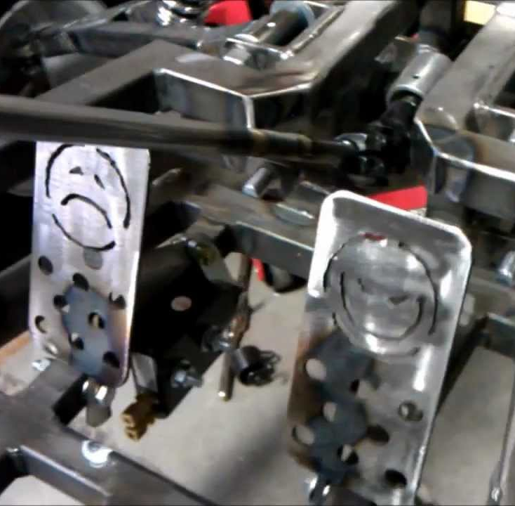
Throttle and Braking Systems Concept: Floor Mounted Pedals
The attachment point of the pedals is moved to the floor.
Reduces the risk of foot slipping off the pedal.
Has a higher risk of getting mud stuck in important components.
Is much more ergonomic and comfortable for longer races.
Notes:
Ben

Slide 23
Throttle and Braking Systems Concept: Hang Mounted Pedals (current system)
The pedals are attached from the top and hang down.
Allows for the driver to exert more force on the brake.
Mud will simply fall off due to the pedals being hanging
There is plenty of space for all the components in the front.
Notes:
Ben

Slide 24






Throttle and Braking Systems Recommended Design: Floor-mounted Throttle, Hang-mounted Brake
The brake will remain where it is, but the throttle pedal will be moved to the floor.
Allows for the driver to exert more force on the brake.
A more ergonomic throttle will reduce the stress on the drivers throttle foot.
The throttle pedal components are smaller and can fit inside the small area underneath.
Notes:
Ben

Slide 25
Throttle and Brake decision matrix
Criterion | Weight | Floor Mounted | Hang Mounted | Split Mounting
Reliability and durability | 35% | 3 | 4 | 4
Ease of operation | 20% | 4 | 4 | 5
Vehicle integration | 15% | 3 | 4 | 3
Ease of fabrication | 20% | 2 | 4 | 4
Total cost | 10% | 3 | 3 | 3
Weighted score | 100% | 3 | 3.9 | 3.95
Notes:
Jacob

Slide 26
Brake system baseline and refinement
Retain the two-circuit hydraulic braking architecture.
Check pedal travel in normal operation and a single-circuit failure.
Use steel or aluminum for the brake pedal and associated components.
Verify the 2,000 N structural requirement separately from normal driver effort.
Notes:
Ben

Slide 27
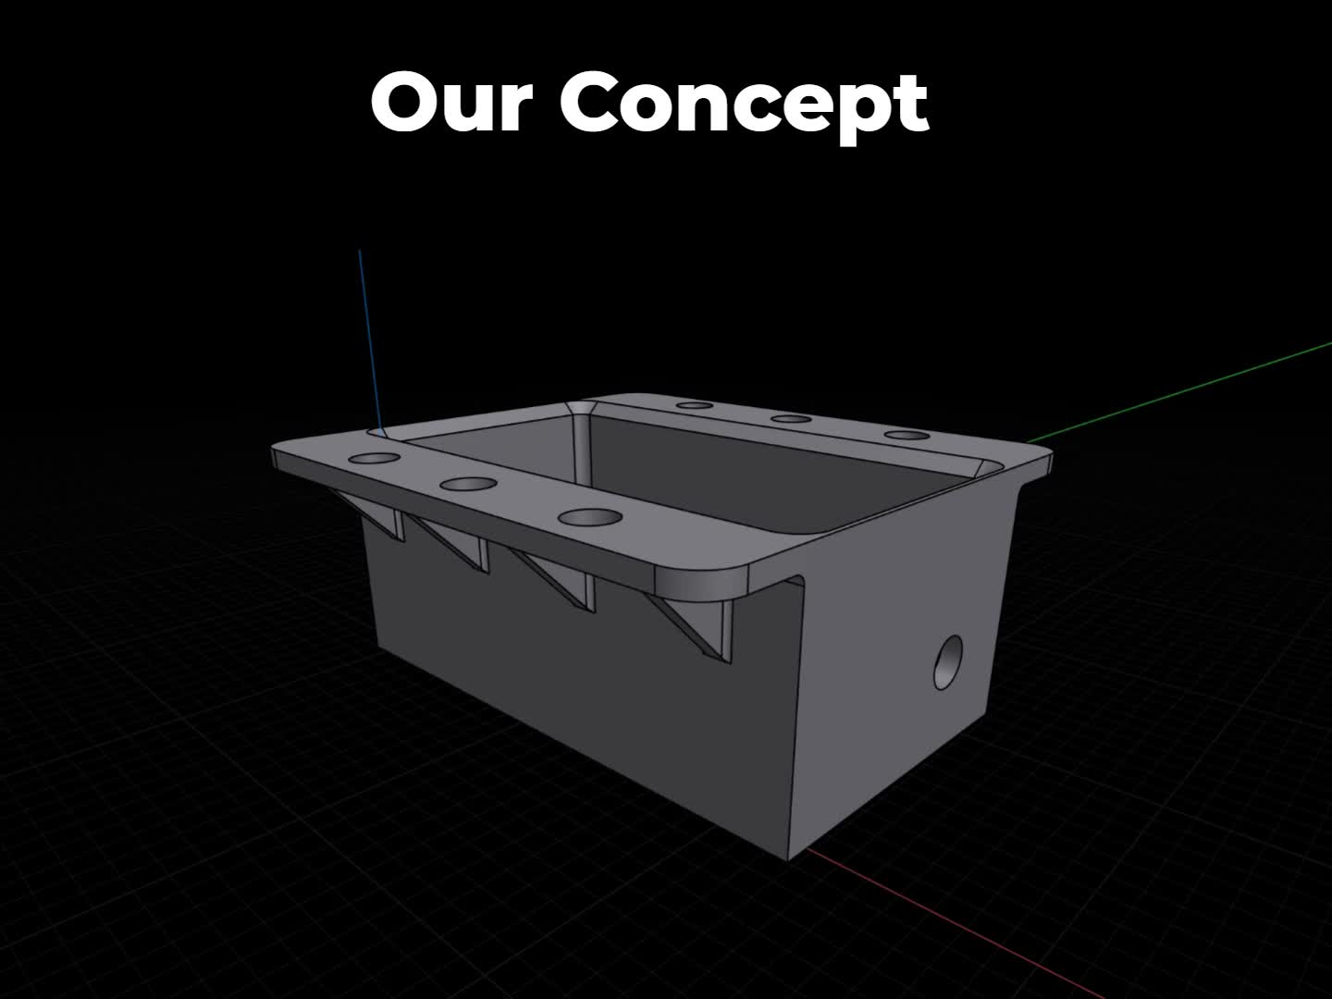
Radio enclosure proof of concept
Customer problem: earlier communications equipment fell off the vehicle.
The printed box uses six attachment points to retain the communications equipment.
Two flat-printed versions were tested: without fins and with support fins.
Function demonstrated: flange retention under a 200 N tensile load.
Notes:
Alex

Slide 28
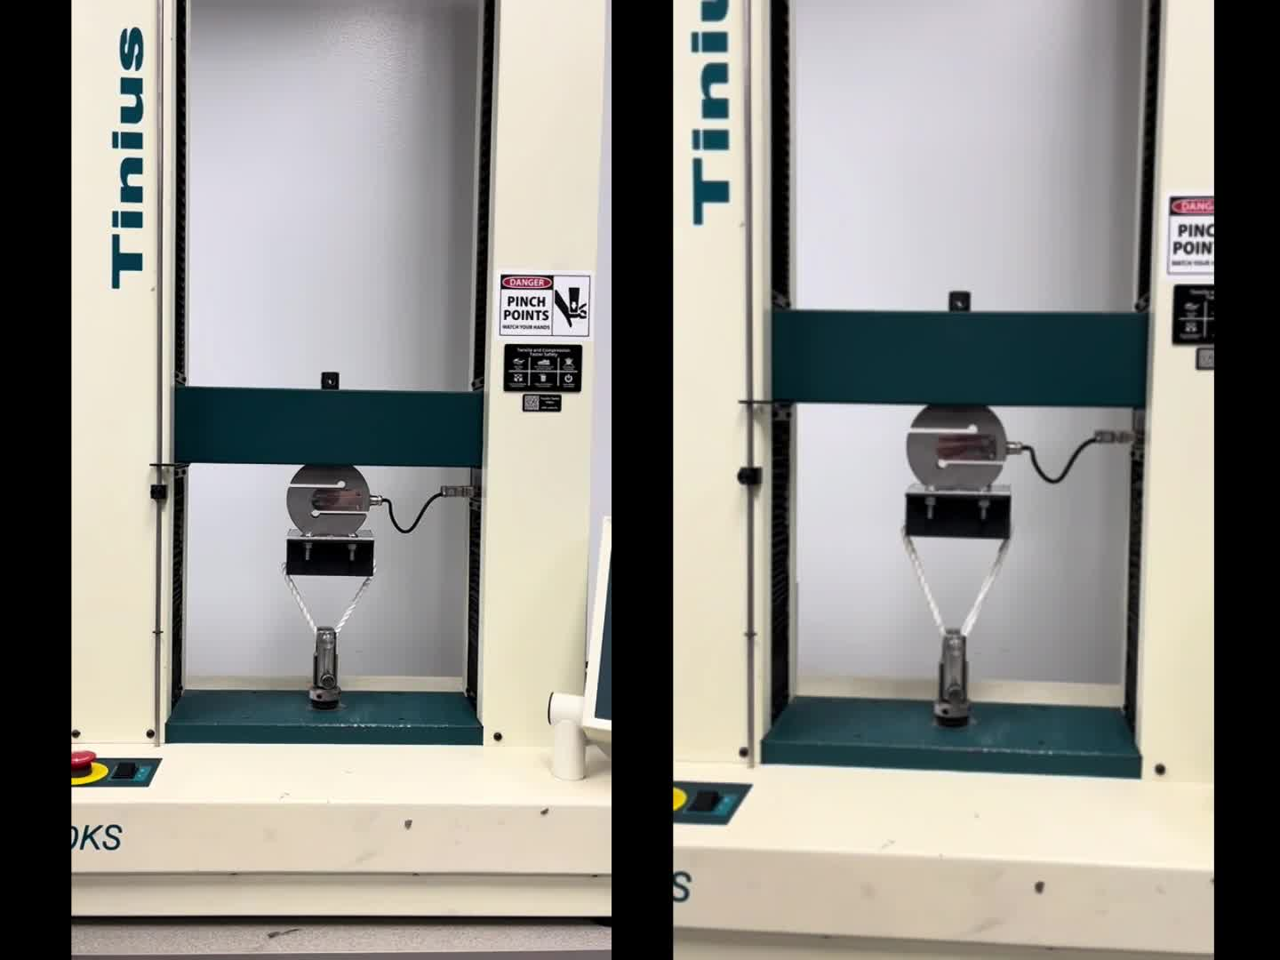
Tensile test setup and comparison
A vertical tensile tester pulls each housing until failure.
The upper fixture bolts to the flange. Rope transfers load from the lower grip to the box.
Left: flat print without fins. Right: flat print with fins between attachment points.
The test evaluates flange retention in the demonstrated fixture and loading direction.
Notes:
Ben

Slide 29
High-level development budget
Budget item | Planning allowance
Steering gears, supports and bearings | $125
4WD cable / lever and selector linkage | $150
Throttle cable, stop and pedal materials | $200
Brake refinements, lines and fittings | $200
Radio / audio integration allowance | $350
Enclosure prints and mounting hardware | $100
Test fixtures and consumables | $75
Contingency, 20% of $1,500 | $300
Total proposed development allowance | $1,500
Notes:
Alex

Slide 30

Completed deliverables
M04
Statement of work
Defined the scope of the controls project.
M05
Concept portfolio
Compared ideas for steering, 4WD engagement and communications.
M06
Proof-of-concept video
Demonstrated the radio housing flange under tensile load.
Notes:
Alex

Slide 31
Remaining deliverables
M07
Preliminary design review
M08
Detailed design
Performance review, updated statement of work, drawings, budget and critical design review.
M09
First build and test
First build demonstration video.
M10
Second build and test
Second build demonstration video.
M11
Final product and handoff
Final design report, Senior Design Night poster, capstone closeout and senior exit survey.
Notes:
Alex

Slide 32
Questions?
Notes:
All

